Slide 1
Soar IDE 2.0

Slide 2
What is it?
Soar IDE is an open-source Eclipse plugin that provides support for writing Soar code
Main site: https://github.com/soartech/soaride
Eclipse update site: https://github.com/soartech/soaride/raw/master/com.soartech.soar.ide.update
Originally released in 2006, it was stable for many years but recently has been getting a lot of attention thanks to PSU ARL as a result of ONR Swampworks sponsorship
The goal is to standardize the Soar community on a single editor
Not to say that people can’t use other editors, but there’s no need to have many complex editors: Soar IDE should replace Visual Soar and Soar Editor

Slide 3
Features
Syntax highlighting
Error and warning markers
Content assist
Templates
Hover help
Dynamic and authorable datamaps of Soar’s working memory
Grouping subsets of files into “agents”
A Source Viewer to display expanded Tcl macros

Slide 4
Creating Agents and Files
Need to enable Soar Support on a project
Right-click on Eclipse project -> Include Soar Project Support
In Package Explorer or Navigator, can right-click to add:
Soar Agent: Defines the files to be included in a Soar agent
A project may have many agents
Information stored in a .soaragent file which has a UI
Soar Folder: Adds a folder with a load.soar file in it
If adding to a directory that already contains a load.soar file, modifies that file to source the new load.soar file
Soar File: Adds a .soar file and an entry to the load.soar file in the same directory
Soar Datamap (authorable): Allows user to defined expected working memory structures
There may be multiple datamaps per agent
Inclusion in an agent means it is selected in the .soaragent file
Datamaps can reference each other (not really tested)

Slide 5
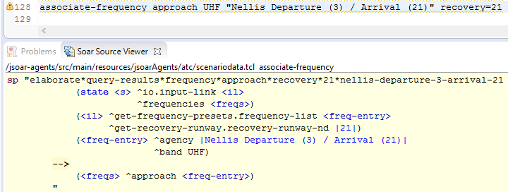
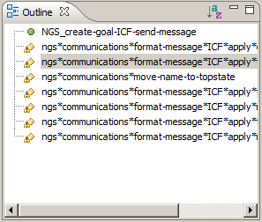
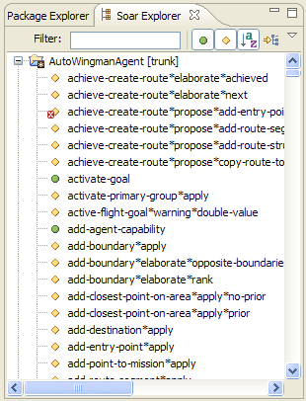
Soar Perspective
The Soar Perspective adds several views:
Outline: List of productions, Tcl procs, Tcl calls, and regions in a file
Allows navigating directly to those parts of the file
Also shows warning and error markers
Soar Explorer: Like Outline, but for entire agents and only productions and Tcl procs
Soar Datamap (dynamic): Shows working memory structures tested and/or created by agents
Agent or file level
Soar Source Viewer
Shows expanded Soar code for selected Tcl calls
Works for Tcl embedded in sp commands and for Tcl macros that generate one or more sp commands

Slide 6
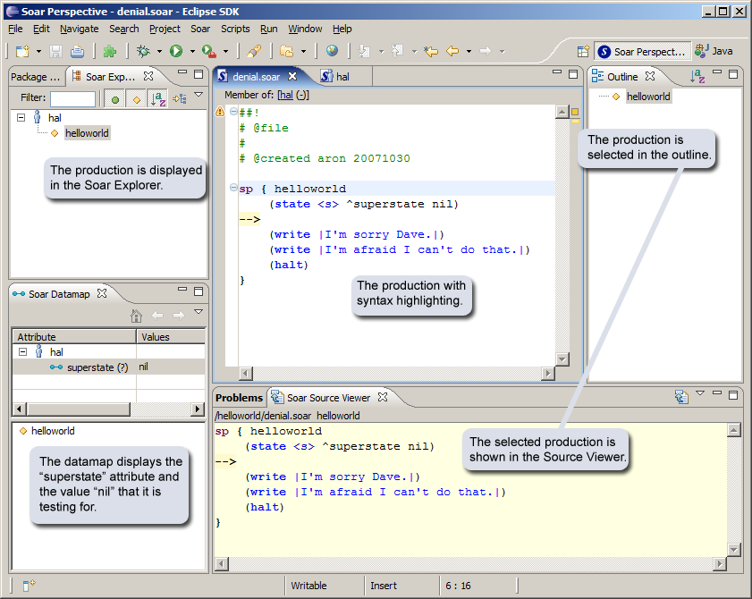
Soar Perspective

Slide 7
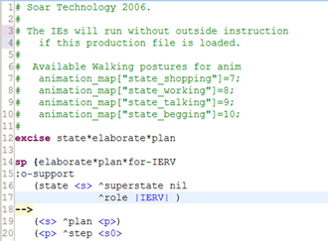
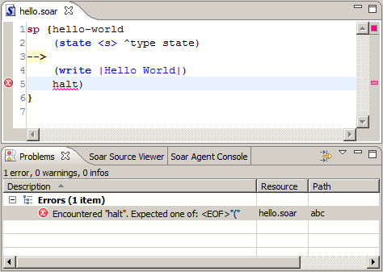
Editor View
Syntax highlighting supports Soar and Tcl
Highlighting is customizable; see Window->Preferences->Soar Editor->Syntax Coloring
Errors and warnings shown as markers in the file and in the Problems View
Syntax errors, file not reachable warnings, missing static datamap entry warnings

Slide 8
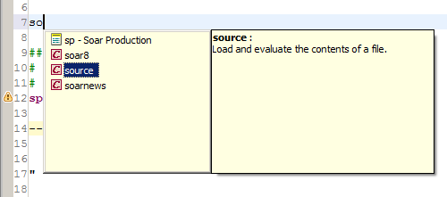
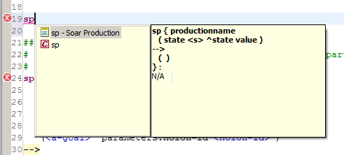
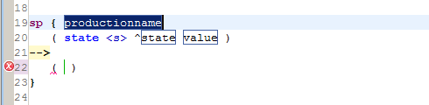
Editor View
Content assist
After whitespace, shows list of Soar keywords and Tcl proc names
After ^, shows list of valid attribute names from dynamic datamap
After <, shows list of valid variables
After [, shows list of valid Tcl macros
Can ctrl+space to show list if doesn’t appear automatically
Templates
User-definable templates can generate any number of sp commands with variabilized parts
See Window->Preferences->Soar Editor->Templates

Slide 9
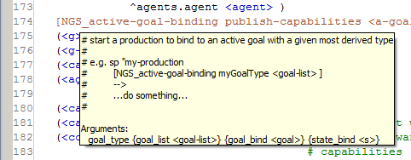
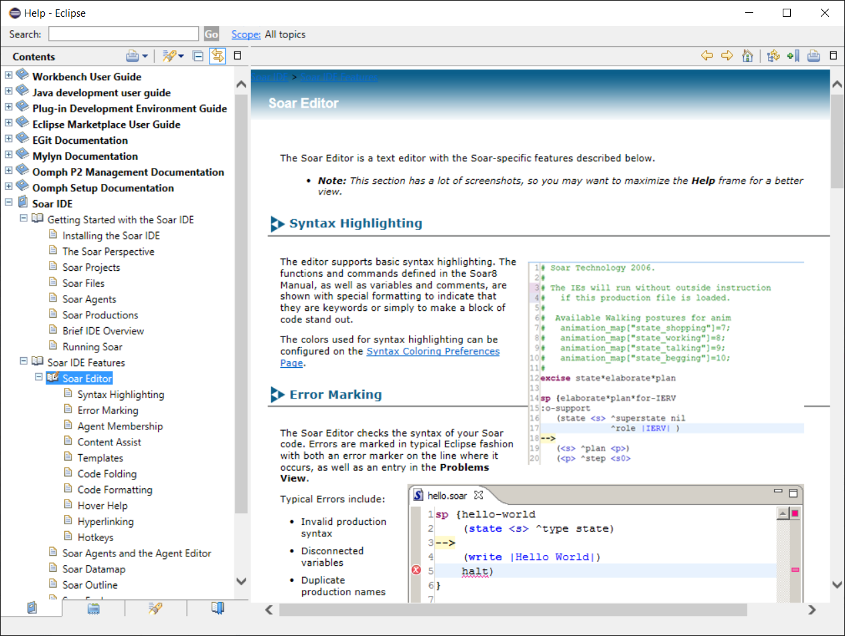
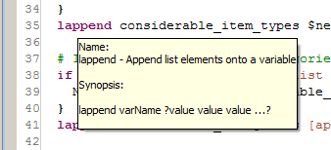
Editor View
Help
Hover over Tcl macro calls to see documentation for that macro
Hover over Tcl variables to see value of that variable
Ctrl-click a Tcl macro call to jump to the macro definition
Help->Help Contents->Soar IDE
A little outdated, but still mostly correct

Slide 10
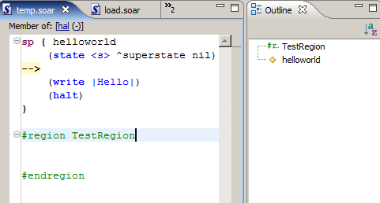
Editor View
Each file shows which agents it belongs to at the top
Region folding
#region regionName
#endregion
Hotkeys
ctrl+shift+f: Auto-format the file or selected text
ctrl+/: Comment/uncomment current line / selected text
alt+/: Auto-completes the word under/adjacent to the cursor. Repeated hits cycle through all combinations.
ctrl+g: Opens any files referencing this one (e.g., files that source this file). Also available in right-click context menu.

Slide 11
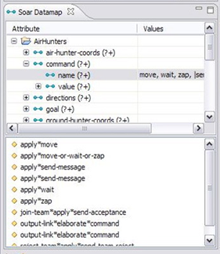
Datamaps
Dynamic datamap
Examines the Soar code and generates a tree view of the working memory structures used
Shows which rules test and/or create various structures
Can be agent or file scoped
Serves as the model for validating the authorable datamap

Slide 12
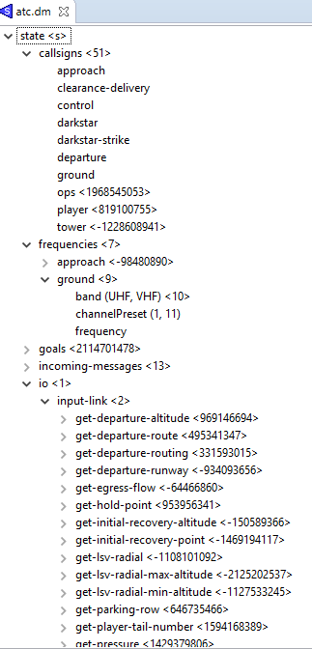
Datamaps
Authorable datamap
Ported from Soar Editor, which ported from Visual Soar
User can define datamap structures in two ways
Via the datamap UI
Via auto-fixing of datamap warnings (right-click on warning marker)
Code for an agent that contains one or more authored datamaps is automatically checked against all datamaps
Specifically, the authored datamaps are checked against the dynamic datamap
Warnings are created for any missing structures
If an agent contains no authored datamaps, it will not show any of these warnings
Should be source-control friendly, but not tested
Current limitation: Does not yet check values

Slide 13
Current Status
Lots of little bugs
Newest features (complex Tcl macro expansion, static datamaps) not well-tested
Not well-tested on non-Windows platforms
Lots of pending feature requests
Expect a new release around the end of the summer
Major future work tasks
Using JSoar internally for many things, but would like to expand usage
Still using separate parser that isn’t quite the same, occasionally resulting in spurious errors
Maybe could use to generate the dynamic datamap model
Usability improvements, especially to authorable datamap (e.g., make it text-based instead of UI-based)
Documentation updates

Slide 14
Resolving Common Problems
A file says it doesn’t belong to any agents
Make sure Include Soar Project Support is selected for the Eclipse project
Make sure there is at least one Soar Agent for that project
Make sure the file is selected in that .soaragent file
If you change any of these things while the file is open, it may not refresh until you close and reopen it
The Source Viewer isn’t show the expansion for my Tcl macro
Follow the above steps, making sure the file you are viewing and the file that defines the macro are both members of the agent
Make sure the Tcl expansion is enabled (toggle the icon on the top-right of the Source Viewer)
Make sure there are no outstanding syntax errors in the agent
Make sure you are selecting a call to a Tcl macro, not the Tcl macro definition
You may have to close/reopen the file, clean the agent, or restart Eclipse
I don’t see the Source Viewer, Datamap, etc.
Make sure you are in the Soar Perspective
If they have become hidden, you can show individual views via Window->Show View->Other->Soar
You can reset the Soar Perspective (right-click on Soar Perspective -> Reset)

Slide 15
Installation
Officially supported on Eclipse Mars 2
Seems to require it now, although this is not intentional
Eclipse update site:
https://github.com/soartech/soaride/raw/master/com.soartech.soar.ide.update
Eclipse update bug
Starting with Mars, Eclipse comes with a plugin called Oomph
Earlier versions of Oomph had a bug that prevented some plugins (including Soar IDE) from detecting updates (initial installation works fine)
This seems to be resolved now, but you may have to update Eclipse and/or Oomph if you have older versions installed
To workaround:
Go to the .eclipse folder in your home directory
Find any files whose names contain “soar”
With Eclipse closed, delete those files
Try the update

Slide 16
Nuggets and Coal
Making steady progress in fixing bugs and adding features
Adding features that are critical to many users (static datamap)
Working with the community (PS ARL) has really helped push things forward
Progress is slow
SoarTech needs more people
Developing complex Eclipse plugins is really hard, and we don’t really have an expert in this area
Re-discovering how a lot of things work
Still not a real IDE, as there’s no built-in debugger support (it’s on the list)

